Slide 2

LEGEND:
Grey area represents the region in which Temi can move in.
Green dot represents Temi.
The blue arrow represents a direction the Temi is moving.
Red dot is another Temi .
1
4
3
2

Slide 3
When the application is started, the temi will move to its idle spot. When the Temi is started, it is expected that the Temi will be at the home base charging. When going to the location, the Temi should not be playing any music.

Slide 4
When Temi has reached the idle spot, it will start playing music. If Temi sees a user, it will start dialogue asking if they would like to do a tour. If a confirmation is given, Temi will move onto the next state of the tour. If a negative or no response is given to Temi, it will remain in the idle spot.

Slide 5
If a user has provide a confirmation to doing a tour the Temi will then move to the greet tour spot. In this spot, the temi will introduce itself to the user and explain how to interact with it during the tour.
Once the explanation is done, the Temi will ask if everyone is ready for the tour. If a confirmation is given, the temi will move onto the next state of the tour.
If a negative or no response is given, the Temi will ask again if they are ready to do the tour.

Slide 6
The next area the Temi moves to will require it to go up a ramp. It should be noted during testing that Temi has difficulty going up the ramps. To ensure that the user does not move Temi (which could cause it to become delocalised) it will say a line of dialogue indicating that it is fine.

Slide 7
Once Temi has gone up the ramp, it would have made it to the first part of the tour. As it goes to this spot, Temi should say something to introduce the user to the spot.
In this spot temi will turn around to face the user. Temi should only continue on with its sequence when it has seen the user. When it has seen the user it will then begin the demonstration. It will ask the user to first move away. Once done, temi will ask the user to move closer. Once done, temi will then enquire the user’s name. If a name is given, Temi will say hi to the user using there given name. Otherwise, temi will say something addressing the fact a name was not given. Once all these actions are done, Temi will begin the rest of the tour.

Slide 8


Temi will now move to predefined points for the tour’s next few states. The sequence done at each location is the following. While going to the location (if it fits well) Temi will being explaining about the location they are going to as they move. In some cases, Temi will only explain when at the location. While explaining, an image will be displayed on Temi that is relevant to the room that is being explained.
At the end of an explanation, temi will enquire if the user would like to ask a question. If a question is given, it will answer. Else no questions given, Temi will move to next location.

Slide 9
At the last tour location, Temi will follow the same sequence as other tour spots. However, when it comes to the point when the user can provide a question Temi will respond that they do not know the answer. If no answer given, Temi will react as normal.
When the Temi gets to the end of tour, if it is able to connect with another Temi it will initiate a conversation. If the user asked a question on the last spot, the Temi that is guiding the user will ask the other Temi if they know the answer. They will then go back and forth with a semi scripted sequence. If the user did not provide a question, Temi will just go based on a scripted response.

Slide 10
Once the Temis have finished talking to each other, the Temi not guiding the tour will go back to its position. The Temi guiding the tour will then move to the end position where it will say good bye to the user. If the user provided a name to Temi at the start of the Tour, the Temi will say there name when saying good bye. Once done saying good bye, the Temi will then go back to the idle spot to wait for the next user to being a tour again.

Slide 12
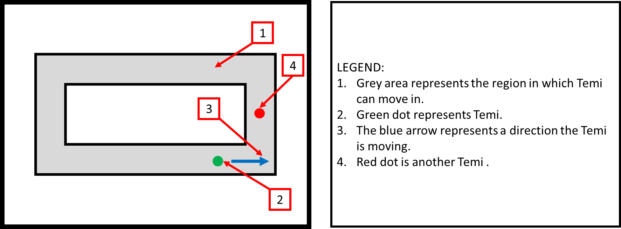
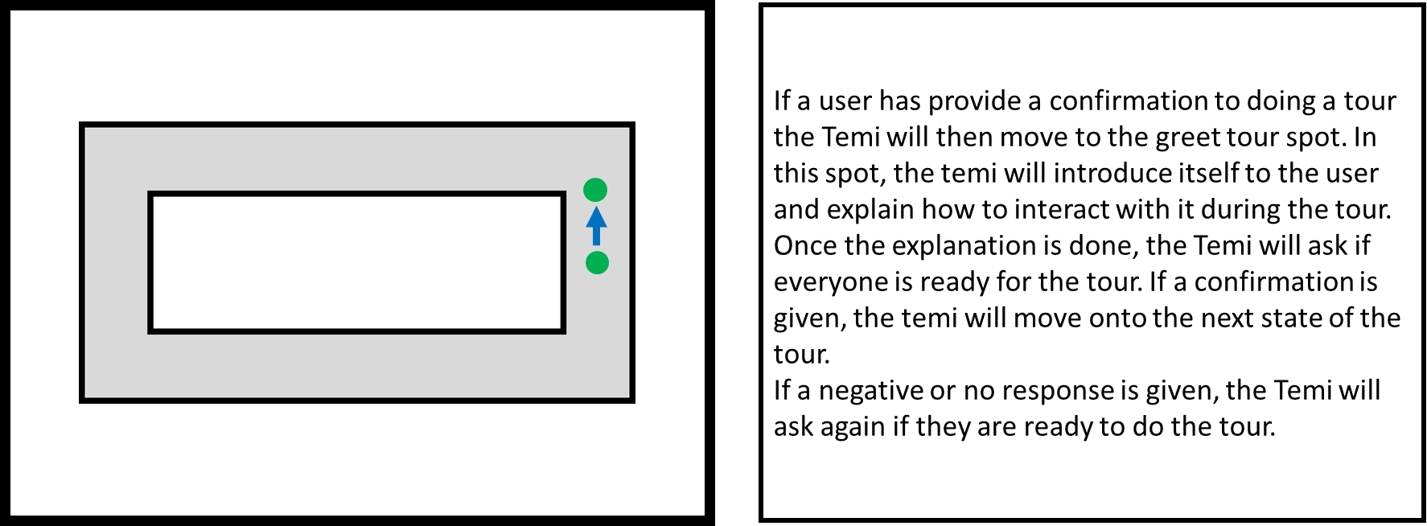
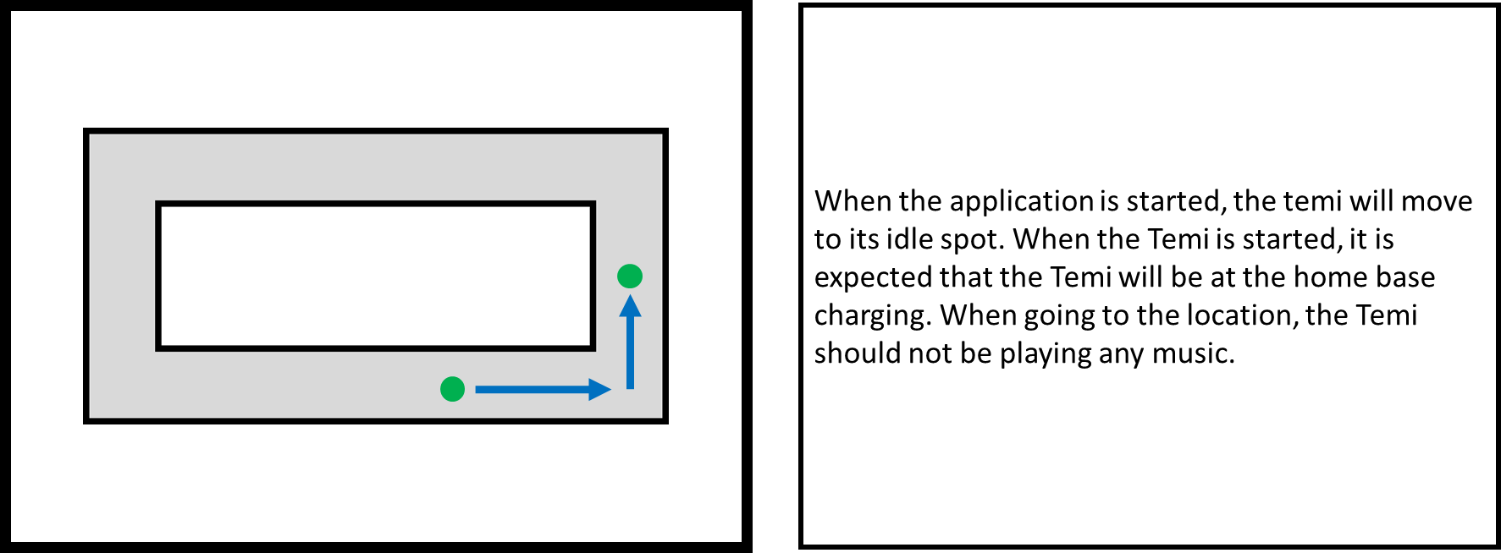
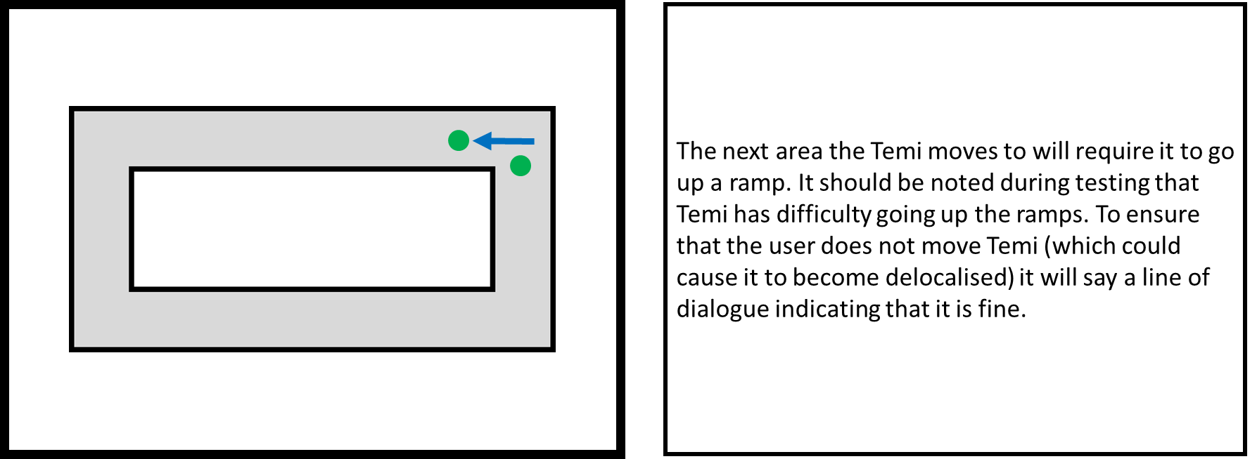
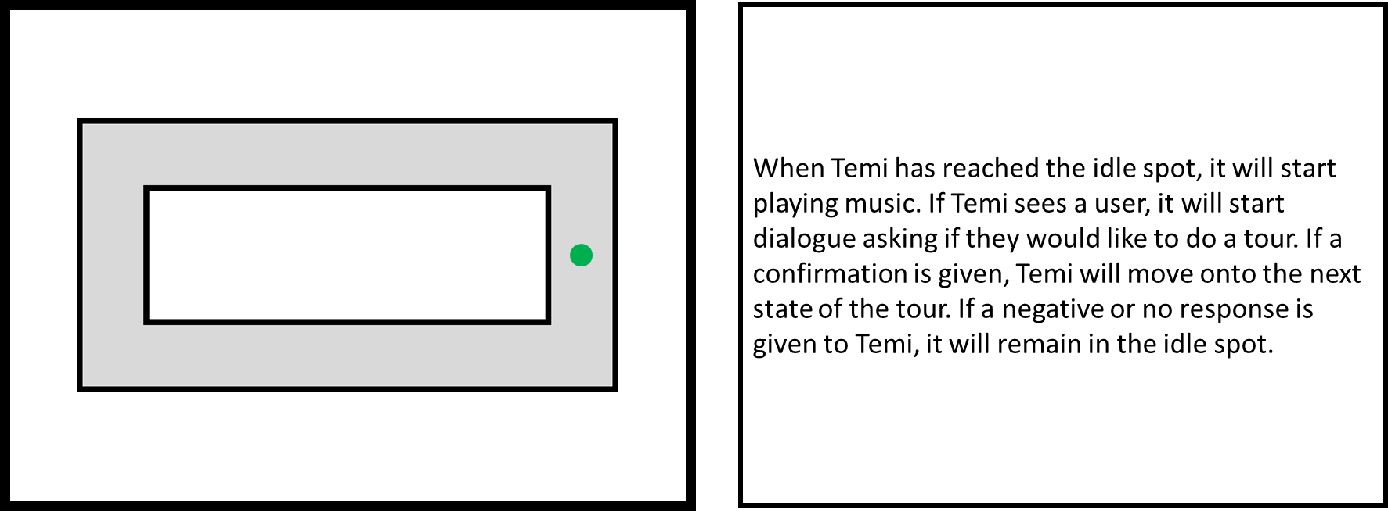
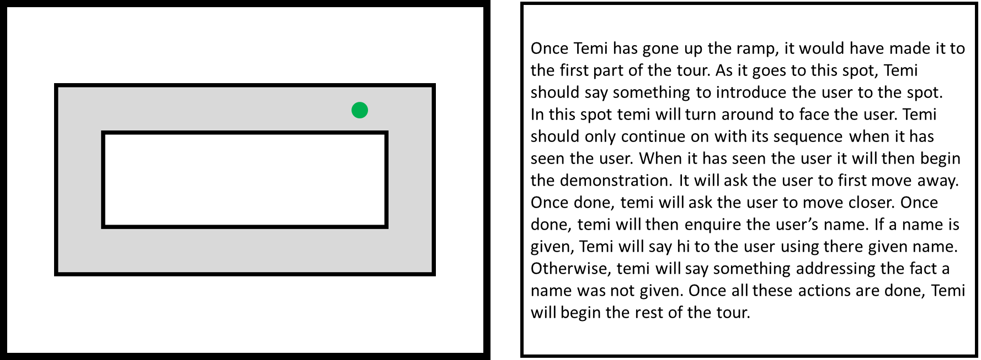
1
4
2
5
3
6

Slide 13
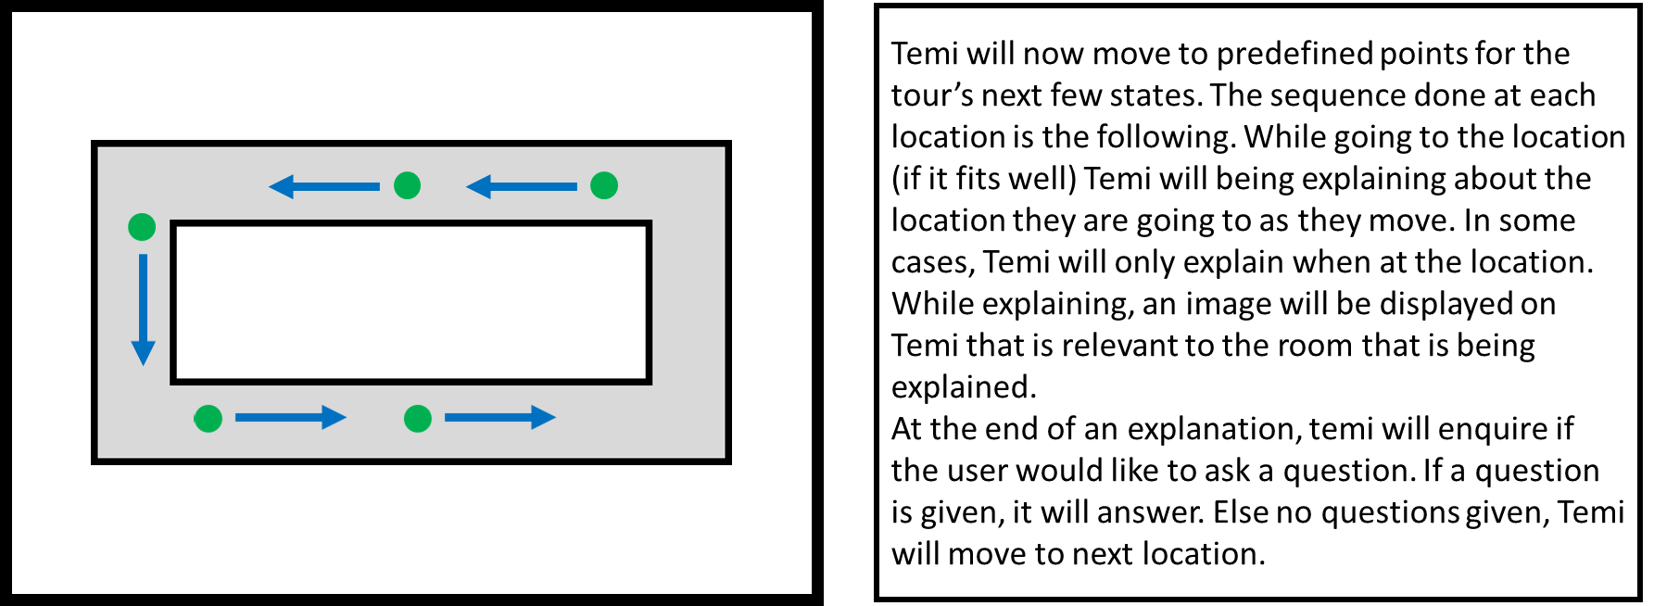
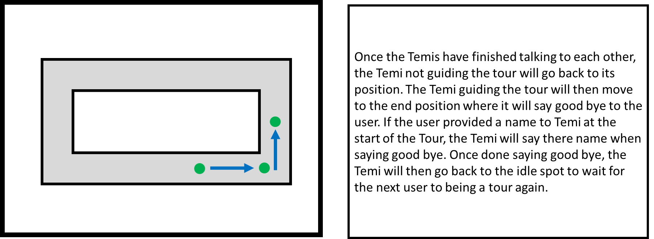
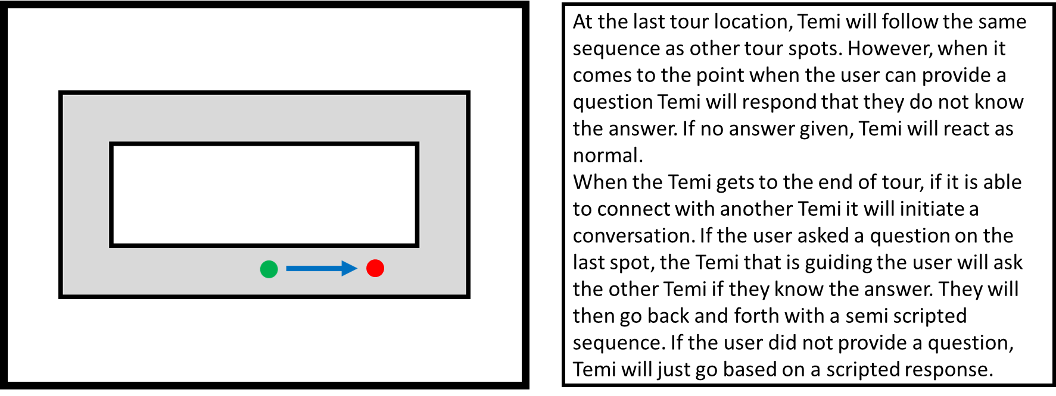
7
9
8

